Slide 1

Stack
Unit-1 Lecture-2
Dr. Dillip Rout, Assistant Professor, Dept. of Computer Science and Engineering

Slide 2
Outline
Fundamentals of Stack
Representation using Array
Applications of Stack:
Parentheses Check
Expression conversion and evaluation
Recursion
Homework
Conclusions

Slide 3
Fundamentals
Introduction
Real-life Usages
Attributes
Operations
Knowledge Check

Slide 4
Overview of Stack
A stack is an ordered collection of elements like arrays.
It has a special feature that deletion (POP) and insertion (PUSH) of elements can be done only from one end called the top of the stack (TOP)
When an element is inserted into a stack or removed from the stack, its base remains fixed where the top of stack changes.
One end is closed, the other end is open.
Due to this property it is also called as Last In First Out (LIFO) type of data structure or First In Last Out (FILO).
It is a linear data structure.
Example:
A stack of Plates/Books/Baskets, Towers of Hanoi, Cycles on stand

Slide 5
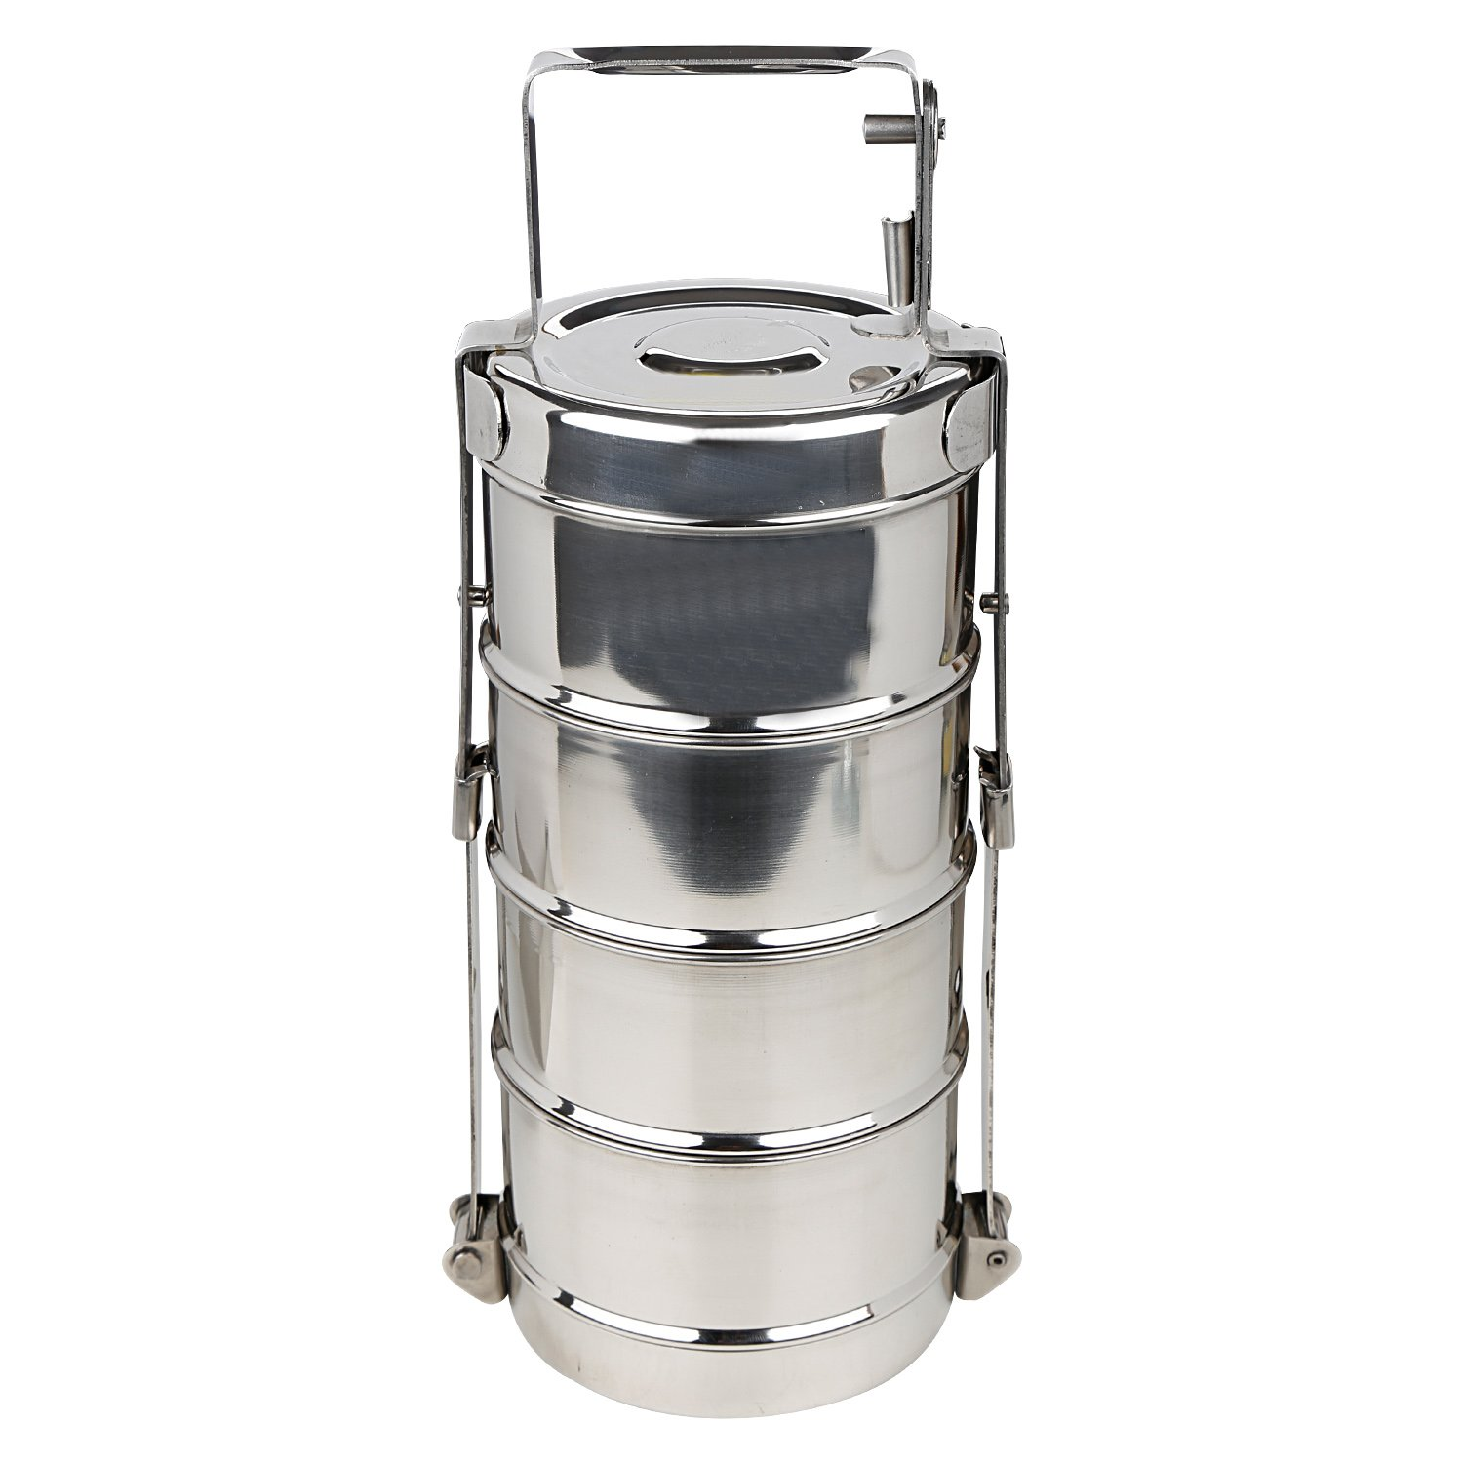
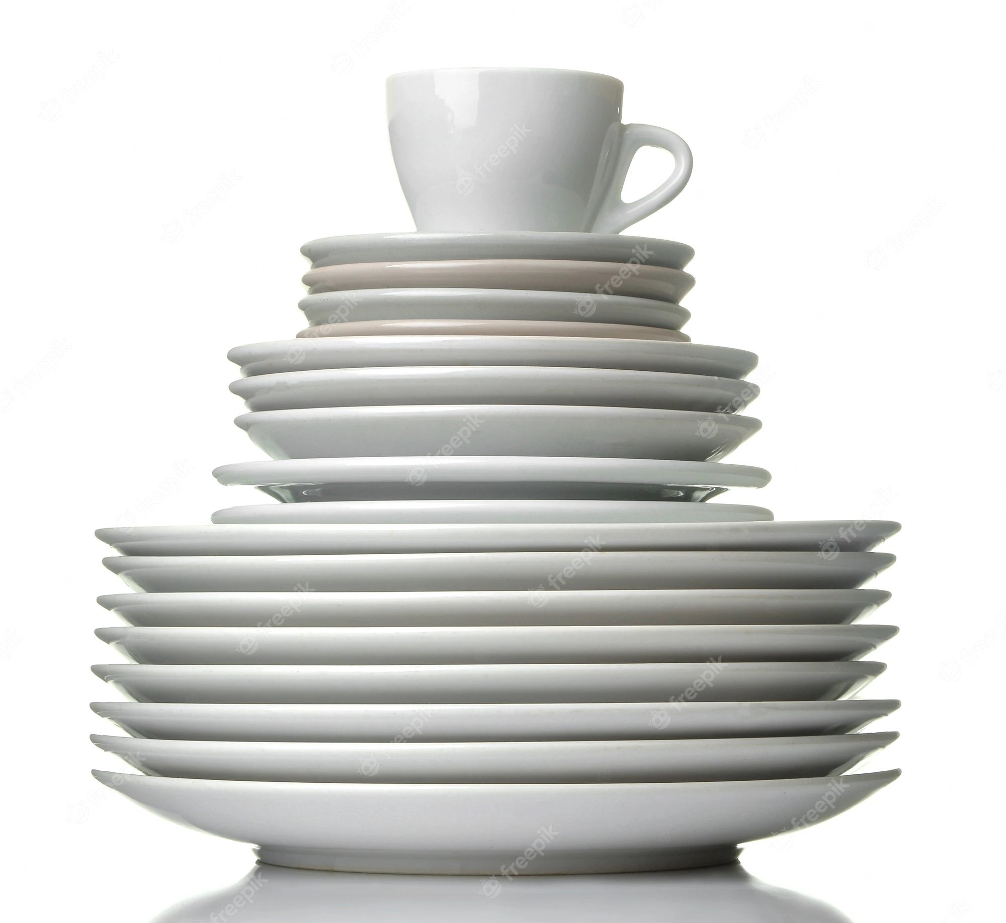
Real-life Stacks
How do you remove the boxes from the lunchbox/tiffinbox?
How do you create a stack of dishes?
Are they stacks???

Slide 6
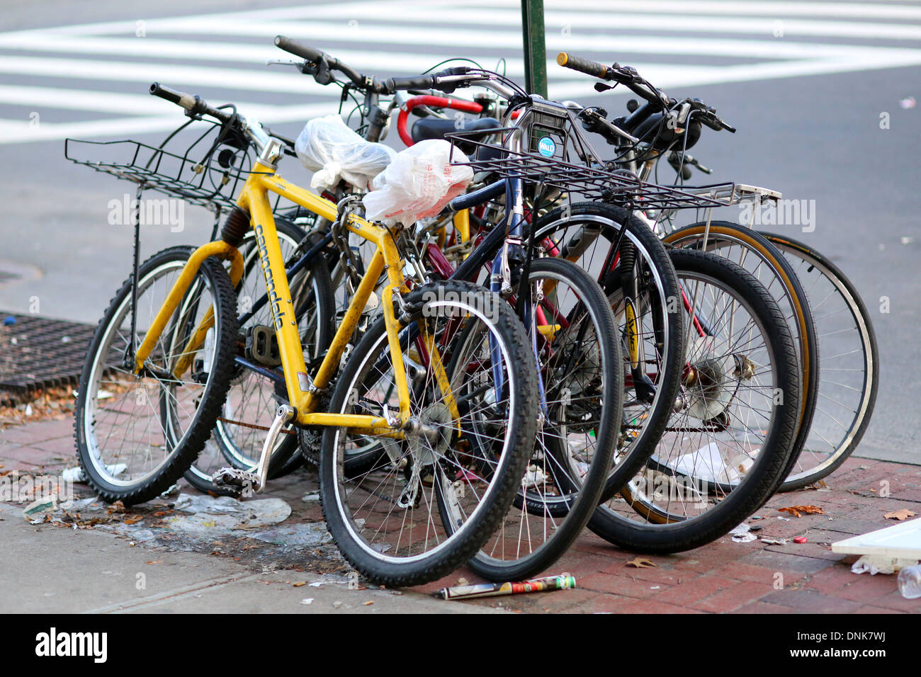
Real-life Stacks…
How do you take out your cycle which is the second one from the pole?
Can you pull it instantly?
Or, are you going to pull out all the cycles previous to yours?
Example of Horizontal Stack

Slide 7
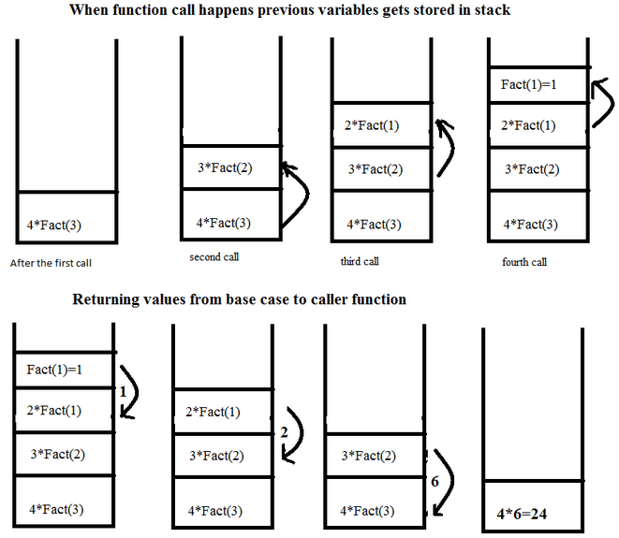
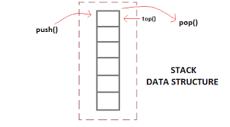
Computer Stacks: Recursive Function Calls

Slide 8
Attributes of Stack
Size:
Mostly predefined and static.
Dynamic size is applied in rare cases.
Top:
The marker which points to the top (outermost) position of the stack.
It sometimes refers to the index of the element at the top position.
As per convention: 0 <= Top < Size where indexing starts at 0
Top < 0 signifies that the stack is empty
Bottom:
The marker which points to the bottom (innermost) of the stack.
Type:
Depends on the dataset

Slide 9
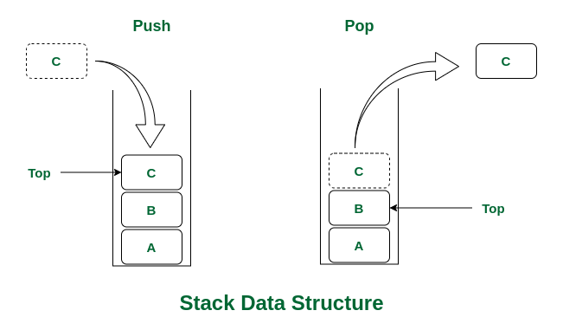
Operations of Stack
Native
Push
Pop
Auxiliary
Display
Peep
Peek
Is it possible to have a horizontal stack?

Slide 10
Push on Stack
Inserts an element on to the stack if possible.
Algorithm Push (S: stack, N: size of stack, Top, x: element to be inserted)
If Top < N - 1 (size of stack) then
Top = Top + 1
S[Top] = x
Return

Slide 11
Pop on Stack
Retrieves and deletes an element from the stack (if possible).
Algorithm Pop (S: stack, Top)
If Top >= 0 then
x = S[Top]
Top = Top - 1
Return x

Slide 12
Knowledge Check
Question
Is Stack a non-linear data structure?
Properties of a Stack?
Answer
No
???

Slide 13
Representation using Array
Define
Underflow
Overflow
Knowledge Check

Slide 14
Define
Defining a Stack means
(Data) Type, Size, Assumptions
It is an non-primitive type, so it needs other data types to be implemented.
For simplicity, let us implement using Array (another non-primitive data type)
Stack can be implemented statically as well as dynamically but assume that it is static.
Let the size of the stack be N
Let us assume that the indexing starts with 0
Let Top = -1 as there are no elements

Slide 15
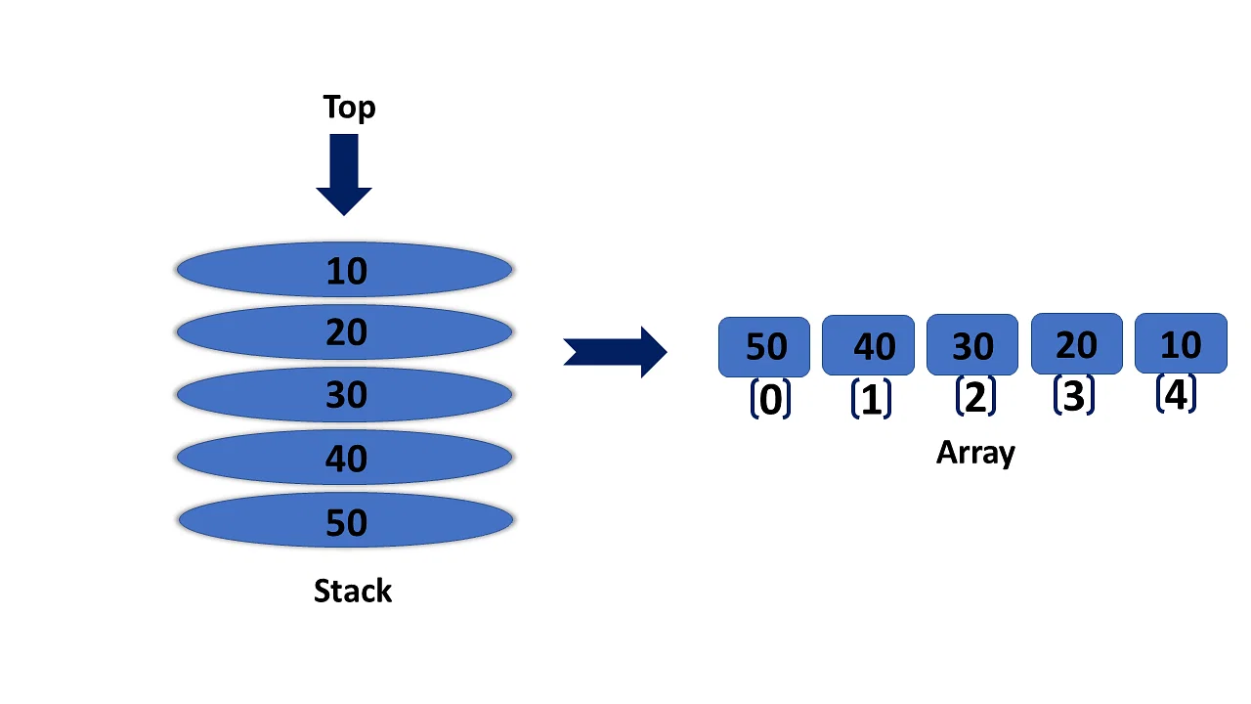
Example of Array Implementation
Can you guess the order of input? At least one order.
What is the value of Top?

Slide 16
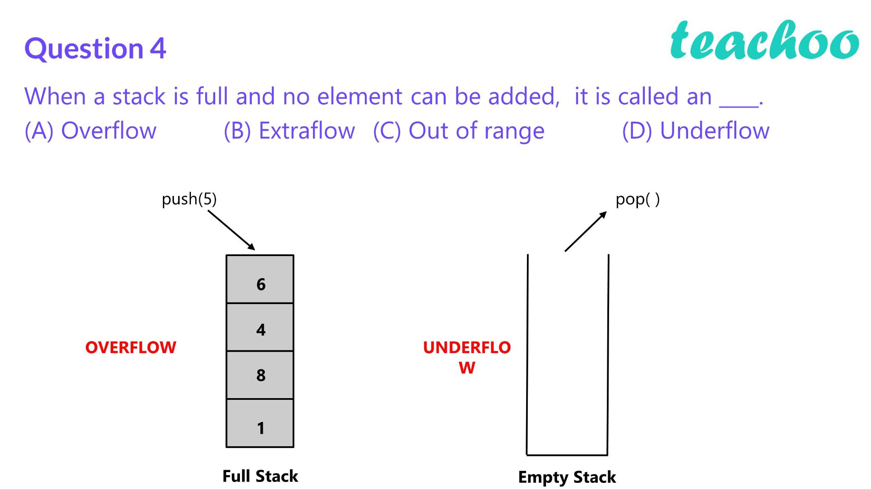
Issues on Stack Operations

Slide 17
Stack Overflow and Underflow (Phenomenon)
Overflow
Occurs while doing Push() operations
Happens if the stack is full
Condition:
Top == N-1
Is there any change required in Push operation?
Underflow
Occurs while doing Pop() operations
Happens if the stack is empty
Condition:
Top == -1
Is there any change required in Pop operation?

Slide 18
Example Problem-1
Q. Define a stack with size 10 and do the following operations.
Push 5
Push 10
Pop
Push 15, 20, 25
Write the state after 3 Pops
Pop, Pop, Pop
Did you encounter overflow?
Did you encounter underflow?

Slide 19
Example Problem-2
while ( there are more characters in the word to read )
{
read a character
push the character on the stack
}
while ( the stack is not empty )
{
pop a character off the stack
write the character to the screen
}
Consider the following pseudocode that uses a stack, declare a stack of characters
(see left panel)
What is output for input "geeksquiz"?
A. geeksquizgeeksquiz
B. ziuqskeeg
C. geeksquiz
D. ziuqskeegziuqskeeg

Slide 20
Example Problem-3
Q. A stack of size (1 to N) and the initial position of top pointer is 0. get (i, S) is a routine to get ith element from stack ‘S’ with respect to top. Then, what is the underflow condition on stack to perform get() operation.
top – i < N
top – i + 1 ≤ N
top – i ≤ 0
top – i + 1 ≤ 0

Slide 21
Applications of Stack
Reversing a String
Parentheses Check
Expression Evaluation
Expression Conversion
Implement Recursion

Slide 22
Real Applications of Stack
Reverse a string
Dealing with undo/redo operations in text editor
Recursion/ function call - Tracking function calls
Backtracking problems
Depth First Search (DFS) - Unit 4
Parsing code:
Matching parenthesis
XML (e.g., XHTML)
Assembly language
Expression evaluation
Reverse-Polish calculators

Slide 23
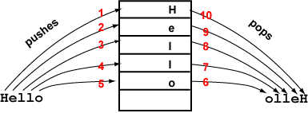
Reversing a String using Stack
Problem Statement:
Given a string (a sequence of characters) find its reverse.
Example:
Input: Hello Output: olleH
Solution Statement:
Use a stack
Read the string character by character from left to right
Push each character into the stack
Stop Push operation after each character is read
Then, Pop each character on the Stack and store into the string
Stop Pop operation once underflow is encountered
Can you check for palindrome?

Slide 24
Application: Parsing
3.2.5
Most parsing uses stacks
Examples includes:
Matching tags in XHTML
In C++, matching
parentheses ( ... )
brackets, and [ ... ]
braces { ... }

Slide 25
Parsing XHTML
3.2.5.1
The first example will demonstrate parsing XHTML
We will show how stacks may be used to parse an XHTML document
You will use XHTML (and more generally XML and other markup languages) in the workplace

Slide 26
Parsing XHTML
3.2.5.1
A markup language is a means of annotating a document to given context to the text
The annotations give information about the structure or presentation of the text
The best known example is HTML, or HyperText Markup Language
We will look at XHTML

Slide 27
Parsing XHTML
3.2.5.1
XHTML is made of nested
opening tags, e.g., <some_identifier>, and
matching closing tags, e.g., </some_identifier>
<html>
<head><title>Hello</title></head>
<body><p>This appears in the <i>browser</i>.</p></body>
</html>

Slide 28
Parsing XHTML
3.2.5.1
Nesting indicates that any closing tag must match the most recent opening tag
Strategy for parsing XHTML:
read though the XHTML linearly
place the opening tags in a stack
when a closing tag is encountered, check that it matches what is on top of the stack and

Slide 29
Parsing XHTML
3.2.5.1
<html>
<head><title>Hello</title></head>
<body><p>This appears in the <i>browser</i>.</p></body>
</html>
<html>

Slide 30
Parsing XHTML
3.2.5.1
<html>
<head><title>Hello</title></head>
<body><p>This appears in the <i>browser</i>.</p></body>
</html>
<html> | <head>

Slide 31
Parsing XHTML
3.2.5.1
<html>
<head><title>Hello</title></head>
<body><p>This appears in the <i>browser</i>.</p></body>
</html>
<html> | <head> | <title>

Slide 32
Parsing XHTML
3.2.5.1
<html>
<head><title>Hello</title></head>
<body><p>This appears in the <i>browser</i>.</p></body>
</html>
<html> | <head> | <title>

Slide 33
Parsing XHTML
3.2.5.1
<html>
<head><title>Hello</title></head>
<body><p>This appears in the <i>browser</i>.</p></body>
</html>
<html> | <head>

Slide 34
Parsing XHTML
3.2.5.1
<html>
<head><title>Hello</title></head>
<body><p>This appears in the <i>browser</i>.</p></body>
</html>
<html> | <body>

Slide 35
Parsing XHTML
3.2.5.1
<html>
<head><title>Hello</title></head>
<body><p>This appears in the <i>browser</i>.</p></body>
</html>
<html> | <body> | <p>

Slide 36
Parsing XHTML
3.2.5.1
<html>
<head><title>Hello</title></head>
<body><p>This appears in the <i>browser</i>.</p></body>
</html>
<html> | <body> | <p> | <i>

Slide 37
Parsing XHTML
3.2.5.1
<html>
<head><title>Hello</title></head>
<body><p>This appears in the <i>browser</i>.</p></body>
</html>
<html> | <body> | <p> | <i>

Slide 38
Parsing XHTML
3.2.5.1
<html>
<head><title>Hello</title></head>
<body><p>This appears in the <i>browser</i>.</p></body>
</html>
<html> | <body> | <p>

Slide 39
Parsing XHTML
3.2.5.1
<html>
<head><title>Hello</title></head>
<body><p>This appears in the <i>browser</i>.</p></body>
</html>
<html> | <body>

Slide 40
Parsing XHTML
3.2.5.1
<html>
<head><title>Hello</title></head>
<body><p>This appears in the <i>browser</i>.</p></body>
</html>
<html>

Slide 41
Parsing XHTML
3.2.5.1
We are finished parsing, and the stack is empty
Possible errors:
a closing tag which does not match the opening tag on top of the stack
a closing tag when the stack is empty
the stack is not empty at the end of the document

Slide 42
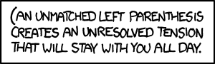
Parsing C++: Parentheses Matching
3.2.5.2
Like opening and closing tags, C++ parentheses, brackets, and braces must be similarly nested:
void initialize( int *array, int n ) {
for ( int i = 0; i < n; ++i ) {
array[i] = 0;
}
}
Cyan for open
Red for closed
We need to ensure that open brackets should be equal to closed brackets with proper type and order.

Slide 43
Parsing C++: Parentheses Matching
The previous example shows how stacks may be used in parsing C++. Compilers will use this.
Solution Statement:
Use a stack
Push when you encounter an open parentheses
Pop when you encounter an open parentheses
At the end, Stack must be empty, otherwise there is an error
Notes:
For other students, it should help understand, in part:
how a compiler works, and
why programming languages have the structure they do

Slide 44
Function Calls
This next example discusses function calls
In ECE 222 Digital Computers, you will see how stacks are implemented in hardware on all CPUs to facilitate function calling
The simple features of a stack indicate why almost all programming languages are based on function calls
Function calls are similar to problem solving presented earlier:
you write a function to solve a problem
the function may require sub-problems to be solved, hence, it may call another function
once a function is finished, it returns to the function which called it

Slide 45
Function Calls
You will notice that the when a function returns, execution and the return value is passed back to the last function which was called
This is again, the last-in—first-out property
Covered in much greater detail in ECE 222
Today’s CPUs have hardware specifically designed to facilitate function calling

Slide 46
Implement Recursion
Solution Statement:
Use a stack to maintain function calls / recursion.
Can you write an algorithm for it?

Slide 47
Expression Evaluation
In mathematics, an expression is a statement having minimum of two numbers, or variables, or both and an operator connecting them.
In programming, an expression is a value, or anything that executes and ends up being a value. It means a mathematical expression.
Example: (a+b) * (c*(d+e)) How is it evaluated?
Do you think parentheses are problematic?

Slide 48
Expression Types
Parentheses in expression does not produce any value, nonetheless it preserves precedence of operators.
Hence, expression is needed to be parentheses free if feasible.
However, removal of parentheses will lead to confusion.
Expressions:
Infix (a+b) * (c*(d+e))
Prefix (Polish Notation) *+ab*c+de
Postfix (Reverse-Polish Notation) ab+cde+**
Both Prefix and Postfix are preferred for faster calculation.

Slide 49
Expression Evaluation using Stack: Postfix
The easiest way to parse reverse-Polish notation is to use an operand stack:
Read the expression from left to right, symbol by symbol
Operand is encountered:
Push it onto the stack
Operator is encountered:
pop the last two items off the operand stack,
perform the operation, and
push the result back onto the stack
End of expression:
Pop the result

Slide 50
Expression Evaluation using Stack: Postfix Example
b=5
a=5
c=10
10
Infix (a+b) * (c*(d+e))
Postfix E = ab+cde+**
Let a=5, b=5, c=10, d=15, e=5
a=5
(a+b)=10
e=5
d=15
c=10
10
d+e=20
c=10
10
d=15
c=10
10
d+e=20
c=10
10
c*(d+e)=200
10
E=2000

Slide 51
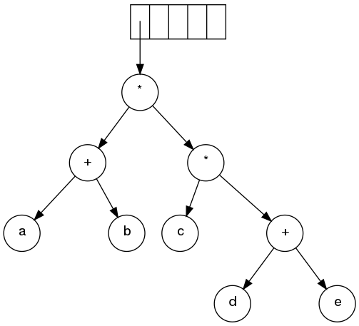
Expression Tree
(a+b) * (c*(d+e))
What if all the parentheses are removed?

Slide 52
Expression Conversion
In general, the expressions are in Infix form.
Infix forms contain parentheses to avoid any sort of confusion in precedence of operators.
There are many rules in any Infix form such as parentheses, precedence of operators, associativity of the operators, order of the operators, type of the operators, etc.
However, these are time consuming for a computer.
Hence, conversion of Infix to Postfix is required to simply the calculation without diluting or ignoring any rules stated above.
Mention that we can also convert Infix to Prefix.

Slide 53
Infix to Postfix/Reverse-Polish Notations
Requires operator precedence information
Read the input expression, for each symbol check if
Operands:
Add to postfix expression.
Open parenthesis/brackets:
Push it on to the top of the stack.
Close parenthesis/brackets:
Pop stack symbols until an open parenthesis/bracket appears of the same type.
Operators:
Pop all stack symbols until a symbol of lower precedence appears.
That is, all the operators having higher precedence will be removed and added to the stack.
Then push the current operator.
End of input:
Pop all remaining stack symbols and add to the expression.

Slide 54
Reverse-Polish Notation
Normally, mathematics is written using what we call in-fix notation:
(3 + 4) × 5 – 6
The operator is placed between to operands
One weakness: parentheses are required
(3 + 4) × 5 – 6 = 29
3 + 4 × 5 – 6 = 17
3 + 4 × (5 – 6) = –1
(3 + 4) × (5 – 6) = –7

Slide 55
Reverse-Polish Notation
3.2.5.4
Alternatively, we can place the operands first, followed by the operator:
(3 + 4) × 5 – 6
3 4 + 5 × 6 –
Parsing reads left-to-right and performs any operation on the last two operands:
3 4 + 5 × 6 –
7 5 × 6 –
35 6 –
29

Slide 56
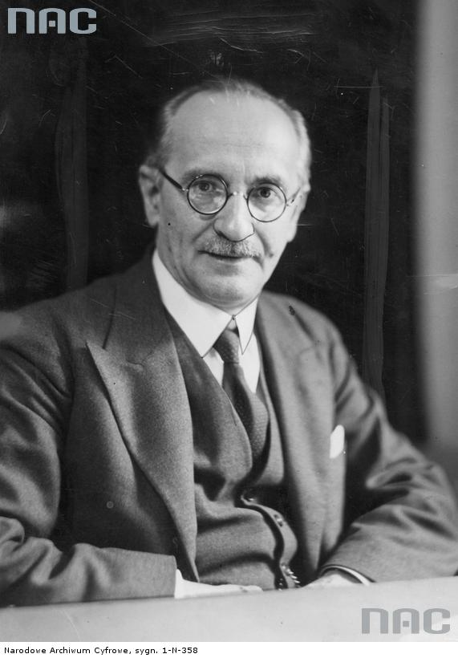
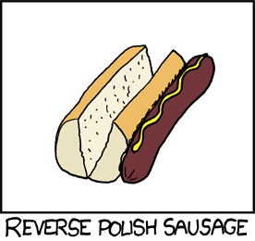
Reverse-Polish Notation
3.2.5.4
This is called reverse-Polish notation after the mathematician Jan Łukasiewicz
As you will see this forms the basis of the recursive stack used on all processors
He also made significant contributions to logic and other fields
Including humour…
http://www.audiovis.nac.gov.pl/
http://xkcd.com/645/

Slide 57
Reverse-Polish Notation
3.2.5.4
Other examples:
3 4 5 × + 6 –
3 20 + 6 –
23 6 –
17
3 4 5 6 – × +
3 4 –1 × +
3 –4 +
–1

Slide 58
Reverse-Polish Notation
3.2.5.4
Benefits:
No ambiguity and no brackets are required
It is the same process used by a computer to perform computations:
operands must be loaded into registers before operations can be performed on them
Reverse-Polish can be processed using stacks

Slide 59
Reverse-Polish Notation
3.2.5.4
Evaluate the following reverse-Polish expression using a stack:
1 2 3 + 4 5 6 × – 7 × + – 8 9 × +

Slide 60
Reverse-Polish Notation
3.2.5.4
Push 1 onto the stack
1 2 3 + 4 5 6 × – 7 × + – 8 9 × +
1

Slide 61
Reverse-Polish Notation
3.2.5.4
Push 1 onto the stack
1 2 3 + 4 5 6 × – 7 × + – 8 9 × +
2
1

Slide 62
Reverse-Polish Notation
3.2.5.4
Push 3 onto the stack
1 2 3 + 4 5 6 × – 7 × + – 8 9 × +
3
2
1

Slide 63
Reverse-Polish Notation
3.2.5.4
Pop 3 and 2 and push 2 + 3 = 5
1 2 3 + 4 5 6 × – 7 × + – 8 9 × +
5
1

Slide 64
Reverse-Polish Notation
3.2.5.4
Push 4 onto the stack
1 2 3 + 4 5 6 × – 7 × + – 8 9 × +
4
5
1

Slide 65
Reverse-Polish Notation
3.2.5.4
Push 5 onto the stack
1 2 3 + 4 5 6 × – 7 × + – 8 9 × +
5
4
5
1

Slide 66
Reverse-Polish Notation
3.2.5.4
Push 6 onto the stack
1 2 3 + 4 5 6 × – 7 × + – 8 9 × +
6
5
4
5
1

Slide 67
Reverse-Polish Notation
3.2.5.4
Pop 6 and 5 and push 5 × 6 = 30
1 2 3 + 4 5 6 × – 7 × + – 8 9 × +
30
4
5
1

Slide 68
Reverse-Polish Notation
3.2.5.4
Pop 30 and 4 and push 4 – 30 = –26
1 2 3 + 4 5 6 × – 7 × + – 8 9 × +
–26
5
1

Slide 69
Reverse-Polish Notation
3.2.5.4
Push 7 onto the stack
1 2 3 + 4 5 6 × – 7 × + – 8 9 × +
7
–26
5
1

Slide 70
Reverse-Polish Notation
3.2.5.4
Pop 7 and –26 and push –26 × 7 = –182
1 2 3 + 4 5 6 × – 7 × + – 8 9 × +
–182
5
1

Slide 71
Reverse-Polish Notation
3.2.5.4
Pop –182 and 5 and push –182 + 5 = –177
1 2 3 + 4 5 6 × – 7 × + – 8 9 × +
–177
1

Slide 72
Reverse-Polish Notation
3.2.5.4
Pop –177 and 1 and push 1 – (–177) = 178
1 2 3 + 4 5 6 × – 7 × + – 8 9 × +
178

Slide 73
Reverse-Polish Notation
3.2.5.4
Push 8 onto the stack
1 2 3 + 4 5 6 × – 7 × + – 8 9 × +
8
178

Slide 74
Reverse-Polish Notation
3.2.5.4
Push 1 onto the stack
1 2 3 + 4 5 6 × – 7 × + – 8 9 × +
9
8
178

Slide 75
Reverse-Polish Notation
3.2.5.4
Pop 9 and 8 and push 8 × 9 = 72
1 2 3 + 4 5 6 × – 7 × + – 8 9 × +
72
178

Slide 76
Reverse-Polish Notation
3.2.5.4
Pop 72 and 178 and push 178 + 72 = 250
1 2 3 + 4 5 6 × – 7 × + – 8 9 × +
250

Slide 77
Reverse-Polish Notation
3.2.5.4
Thus
1 2 3 + 4 5 6 × – 7 × + – 8 9 × +
evaluates to the value on the top: 250
The equivalent in-fix notation is
((1 – ((2 + 3) + ((4 – (5 × 6)) × 7))) + (8 × 9))
We reduce the parentheses using order-of-operations:
1 – (2 + 3 + (4 – 5 × 6) × 7) + 8 × 9

Slide 78
Reverse-Polish Notation
3.2.5.4
Incidentally,
1 – 2 + 3 + 4 – 5 × 6 × 7 + 8 × 9 = – 132
which has the reverse-Polish notation of
1 2 – 3 + 4 + 5 6 7 × × – 8 9 × +
For comparison, the calculated expression was
1 2 3 + 4 5 6 × – 7 × + – 8 9 × +

Slide 79
Knowledge Check
Q1. ISRO2017-59: The best data structure to check whether an arithmetic expression has balanced parenthesis is a:
Queue B. Stack C. Tree D. Linked List
Q2. Consider a stack with 100 elements present. Suppose in a scenario, we are required to remove the first inserted element in it, which is done by POP operations followed by PUSH operations with intermediate elements temporarily being saved in an array. After 10 such removals, without any other intermediate PUSH/POP operations, total number of PUSH operations required is ______

Slide 80
Example Problem-1
Suppose you have been given the following expression.
((1 – ((2 + 3) + ((4 – (5 × 6)) × 7))) + (8 × 9))
You need to convert it into postfix notation. Assume that you will be using a stack with array implementation for doing the conversion. In this case, what is the minimum size of the stack to guarantee that the conversion will be successful.
*Note: If you have very low size of the stack then overflow may occur while you are storing the operators or open brackets in the stack.

Slide 81
Example Problem-2
Suppose you have been given the following expression.
1 2 – 3 + 4 + 5 6 7 × × – 8 9 × +
You need to evaluate the above postfix expression. Assume that you will be using a stack with array implementation for doing the evaluation. In this case, what is the minimum size of the stack to guarantee that the conversion will be successful.
*Note: If you have very low size of the stack then overflow may occur while you are storing the operands in the stack.

Slide 82
Homework
Theory
Practical

Slide 83
Homeworks
Modify Push operation in such a way that it will incorporate overflow condition. (Algorithm)
Modify Pop operation in such a way that it will incorporate underflow condition. (Algorithm)
Write an algorithm for Display operation.
Differentiate between Push and Pop operations.
Write short notes on Top.
Which of the following permutations can be obtained in the output (in the same order) using a stack assuming that the input is the sequence 5, 7, 8, 4, 6 in that order?
a)6, 8, 4, 7, 5 b)6, 4, 5, 7, 8 c)6, 4, 7, 8, 5 d)7, 8, 4, 6, 5
Which one of the following is an application of Stack Data Structure?
A Managing function calls, B The stock span problem, C Arithmetic expression evaluation, D All of the above
You know that function calls or recursions are managed by using a stack. Can you write an algorithm for it?
Write algorithm for evaluating expression using Prefix notation and stack.
Compare Prefix and Postfix evaluation? Report the time. Why does computer prefer Postfix?

Slide 84
Conclusions
Summary
Conclusions
Further Reading

Slide 85
Summary
A stack of plates placed on table in a party, a guest always takes off a fresh plate from the top and the new plates are placed on to the stack at the top.
Stack is a Linear Data Structure that can be implemented in Array (Static) or Linked List (Dynamic)
Stack properties: Size, Type, Top, Bottom
Stack operations: Push, Pop | Display, Peek, Peep
Stack is used for Recursion, Expression Evaluation, Expression Conversion, etc.
The stack is the simplest of all ADTs
Understanding how a stack works is trivial, however, is not in the implementation, but rather: Where possible, create a design which allows the use of a stack
We looked at: Parsing, function calls, and reverse Polish
Solving GATE or other competitive examination question is the key to learn

